Slide 1

DNA Center and Tableau Integration
GVE DevNet
Global Sales Segment : Global Service Provider
Industries : Cities and Communities
LoB : Operations Analytics
Architectural Plays : Enterprise Networking
Sales Plays : None
Alvin Lau
Associated System Engineer
Apr 2020
Notes:
Notes: If your use case applies to morer than one or even all industries please keep all the industries and BOLD the industry where the PoV fits.
Smart City/Health Care/Industry and Manufacturing/Hospitality/Education/Retail/Utilities/Logistics/Professional Services/Public Sector/Service Provider
For LoB applies the same : if there is just one LoB, delete others, and bold the LoB that PoV is about.
LoB ; Safe and Security/Operations Automation/Human Resources/Operation Analytics
Please only keep the Architectural Plays that PoV is about.
Architectural Play : Enterprise / Data Center / Security / Collaboration / Service Provider

Slide 2

Cities and Communities
Operations Analytics
Notes:
Please under Industry Alignment just types the Industry that PoV was created as well LoB
For the pictures, when you go to the bx.cisco.com link and select brand categories and the select photograpy you can use the engine text box to look for industry pictures and download it

Slide 3
DNA Center and Tableau Integration
Business Needs/Challenges
Need: The customer wants to improve his wireless network service SLA by applying analytics. There are some insights that need to be customized and display as the actual tool does not offer this option.
Challenge: Wireless network data in DNA Center is stored only for 14 days. The data needs to be store for longer period of time.
Solution
Export wireless network data using SDN controller and display it using a third-party data reporting tool. With the data extracted, it can be provided customizable data analysis by the customer
Business Outcomes
This allows the customer to better analyze wireless network data, from any time span
Provide the right-on-time information that allow execute business decisions faster.
Provide Assurance for the quality of wireless services.
Notes:
Notes :
At the top Select a short name of the PoV naming product or products involved
Insert the logo f the customer when applies (if it is a general use case ignore the insert logo)
For Business Needs/Challenges :
For bullet Need : Write a small sentence that in an objective way to express the problem to solve when you refer to this problem, avoid to use technical words, uses business language as C-Level
For bullet Challenge : Write the main challenge and drawback the customer has to solve the problem (also avoid technical words, make a message in C-Level)
Solution :
Describe in a small sentence what is the solution about to deal with the problem referred, again, please avoid to uses technical words and use C-Level language
Business Outcomes:
Use small paragraph to show the benefits and gains with the solution explained above, please avoide to uses technical words and use C-Level language

Slide 4
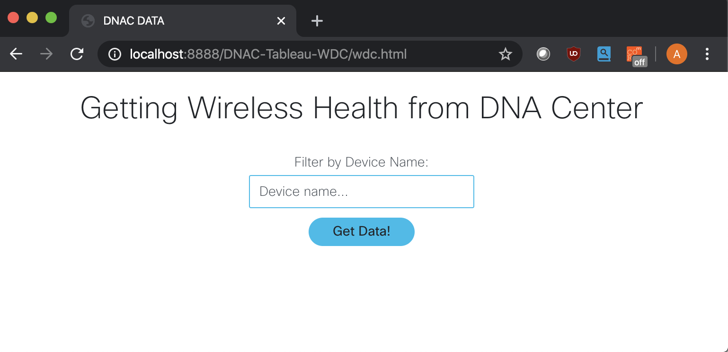
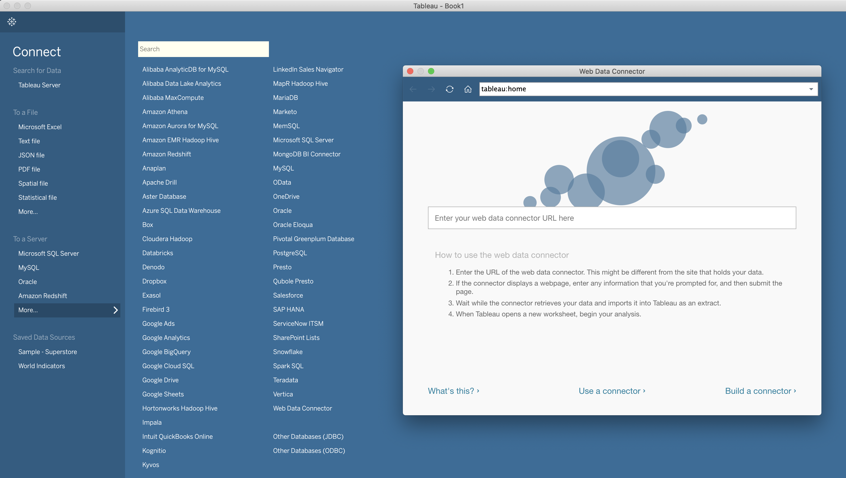
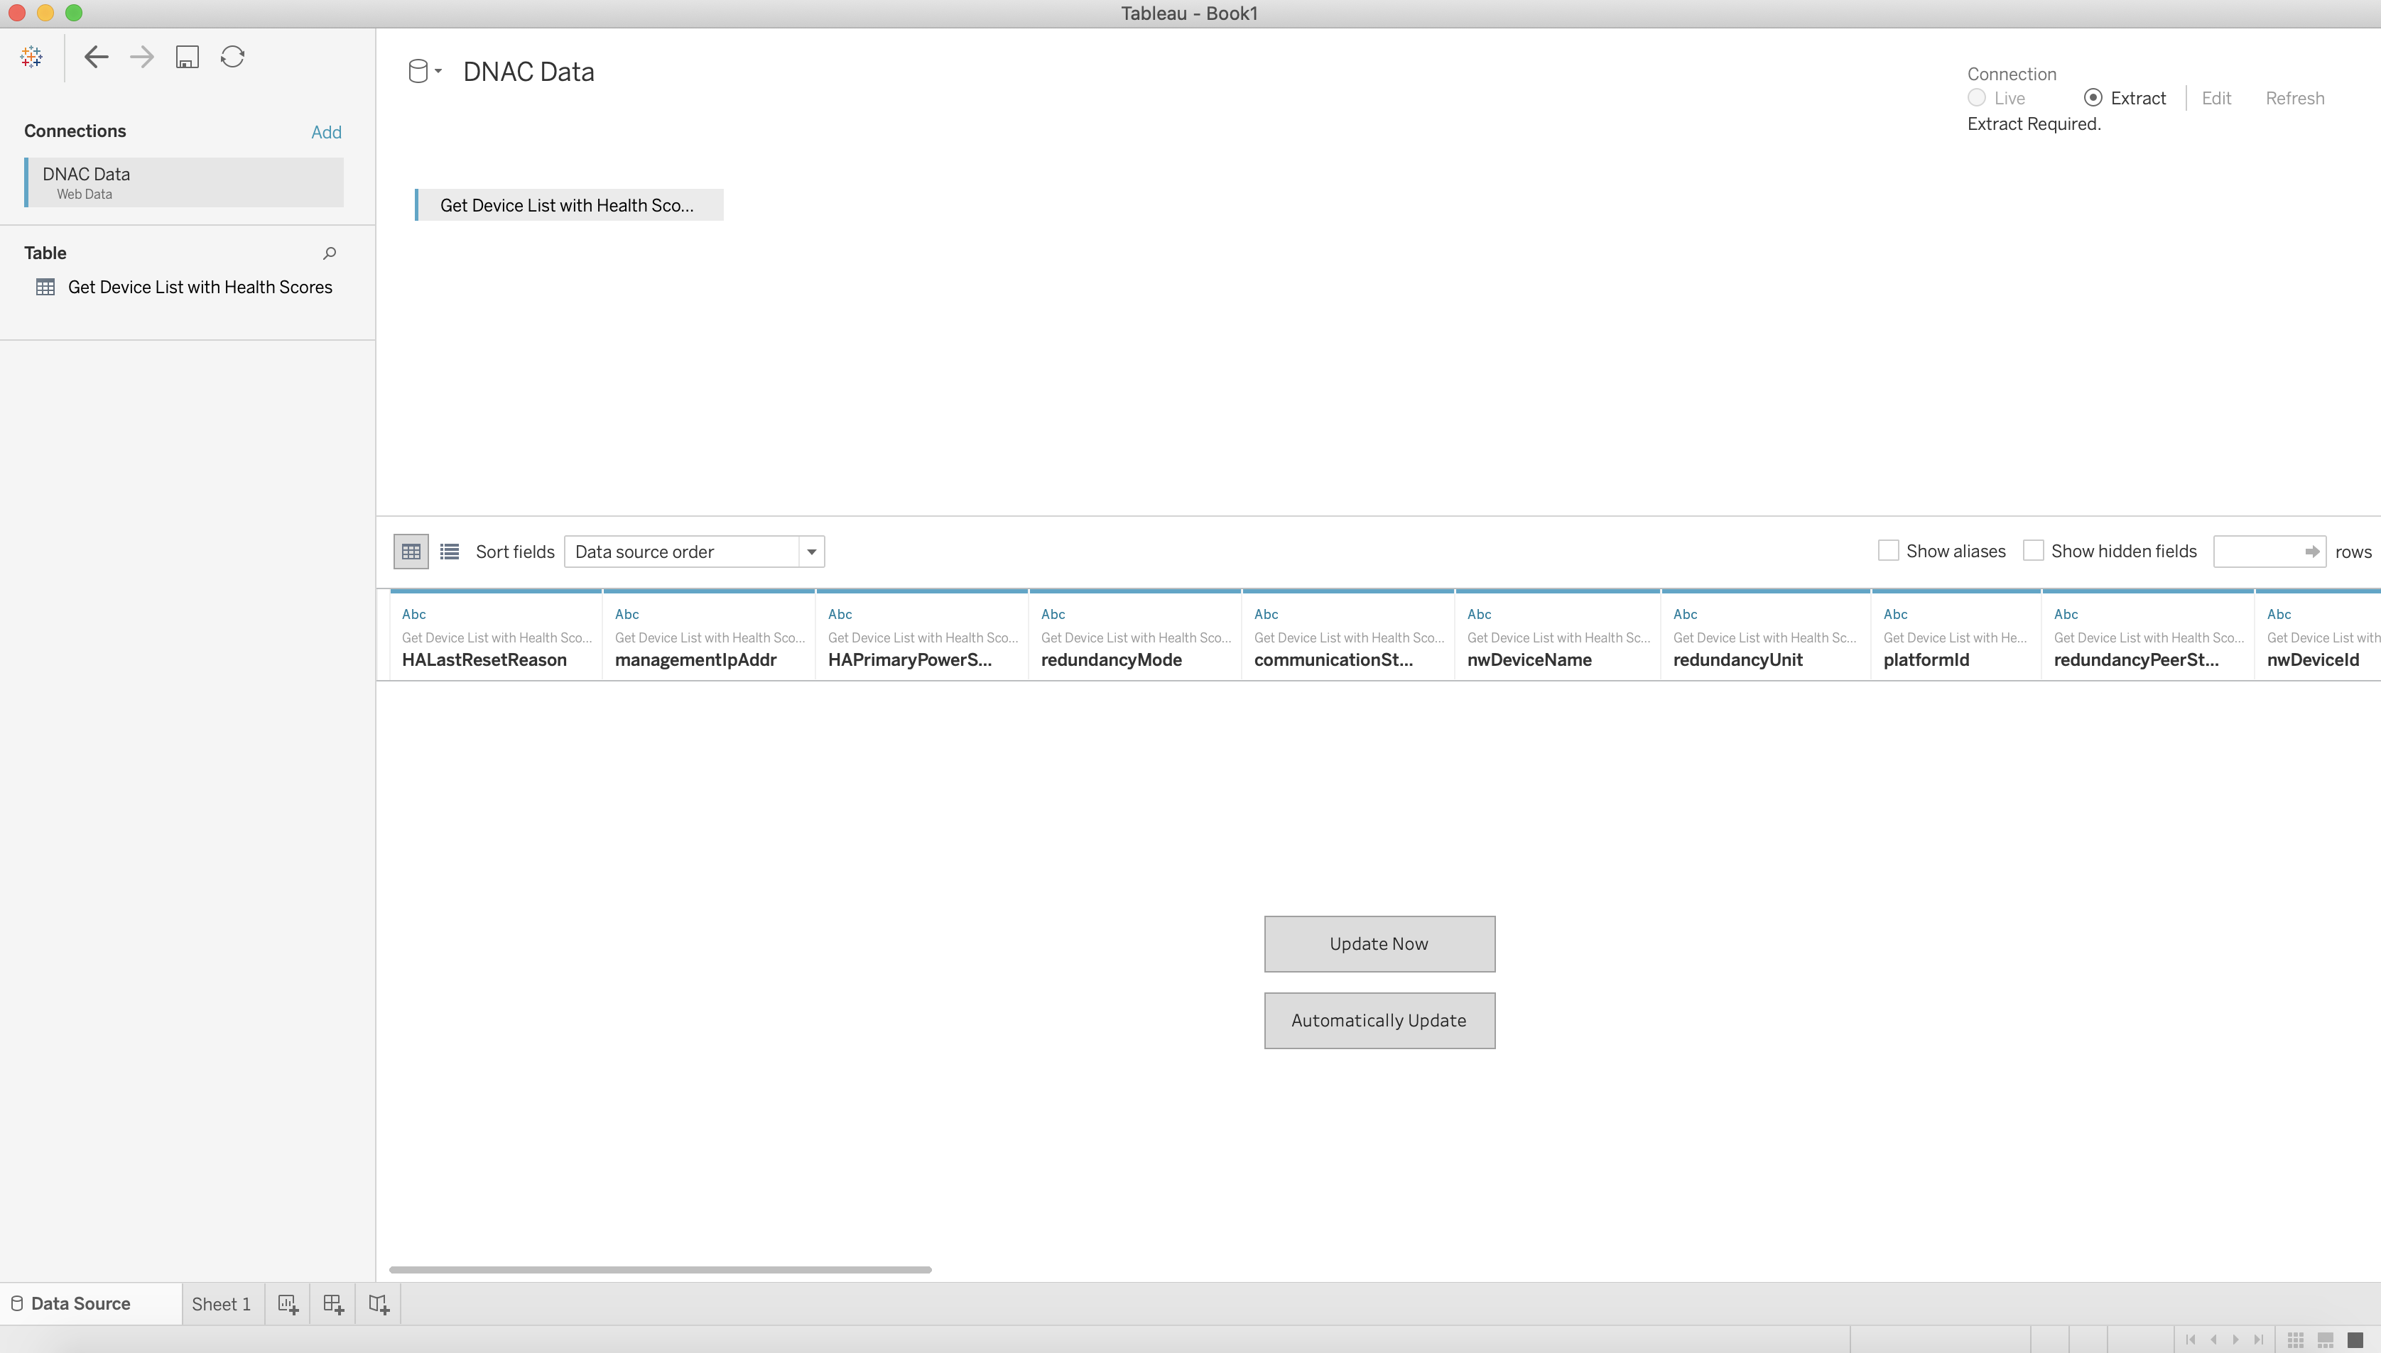

DNA Center and Tableau Integration
Integration Process
Connect to WDC
Get Data
Host WDC
Host the Web Data Connector (WDC)
From Tableau, connect to WDC by putting the address hosting WDC
Proceed to add filter to network device, then import data from DNA Center into Tableau
Initial repo: https://wwwin-github.cisco.com/alvlau/DNAC_Tableau_Integration
Notes:
Notes :
Use this slide to explain the story around your solution. It is a prototype in high level point of view. Think about a explanation of your solution to an executive that does not know Cisco and deep dive technology
This slide it is also to share knowledge with a non-technical guy (like BDM or sales or C-Level) what is the solution about and how will work . You can do as many steps as you need to describe the main flow of the solution
LINK for Icons https://www.flaticon.com/

Slide 5
DNA Center and Tableau Integration for wireless service
Customer / Opportunity
Customer, Municipio de Guayaquil, is one of the biggest service providers in Ecuador, it is going to provide access points to their own customers.
What is the story? What was the business challenge?
Being a service provider leasing access points, the customer needs to constantly reveal the wireless health to ensure the quality of the service always if offering the SLA expected for the users. Also, the wireless network data can get business insights to drive better decisions. However, currently DNA Center can only provide network data up to 14 days, which is too short for analysis.
What the PoV accomplished?
This PoV showcases the integration using DNA Center with the DNA Center Intent API, to extract information for the wireless network, store the data to have the possibility to have insights longer than 14 days and display it into customized dashboard using third party solution – Tableau as the data reporting tool.
What are the benefits to the customer?
Be able to store network data without constraint of time span and to use data reporting tool in place to create analytic dashboard so that operation efficiency can be enhanced.
Notes:
Notes :
*** From the side to the rest you can use all technical wording and reference from Cisco APIs, integrations and tools
Please fill the slide thinking about technical people and the scope of this PoV (what it is cover from the solution proposed and if there is a limitation or need a special integration to be awared
Align the bullet
What are the benefits to the customer?
With the Business Outcomes that you explain in the business case slide. And also you can add technical benefits on this slide or future steps to be added later as following steps

Slide 6
High Level Design PoV
Javascript
Tableau Web Data Connector
DNA Center
DNA Center APIs
DNA Center API
REST API
Tableau App
wdc.html
wdcdata.js
Imported data from DNA Center
Viewed from Tableau
EPNM
Tableau Connector
Event flow
Host WDC
Tableau App
Connect to WDC
User
15454-DWDM
Future Devices
NCS100x
Notes:
Notes:
Describe the High level design and flow for the PoV and mentioned the tools used
Do not forget to add the link to github repository or other specifcs needs

Slide 7
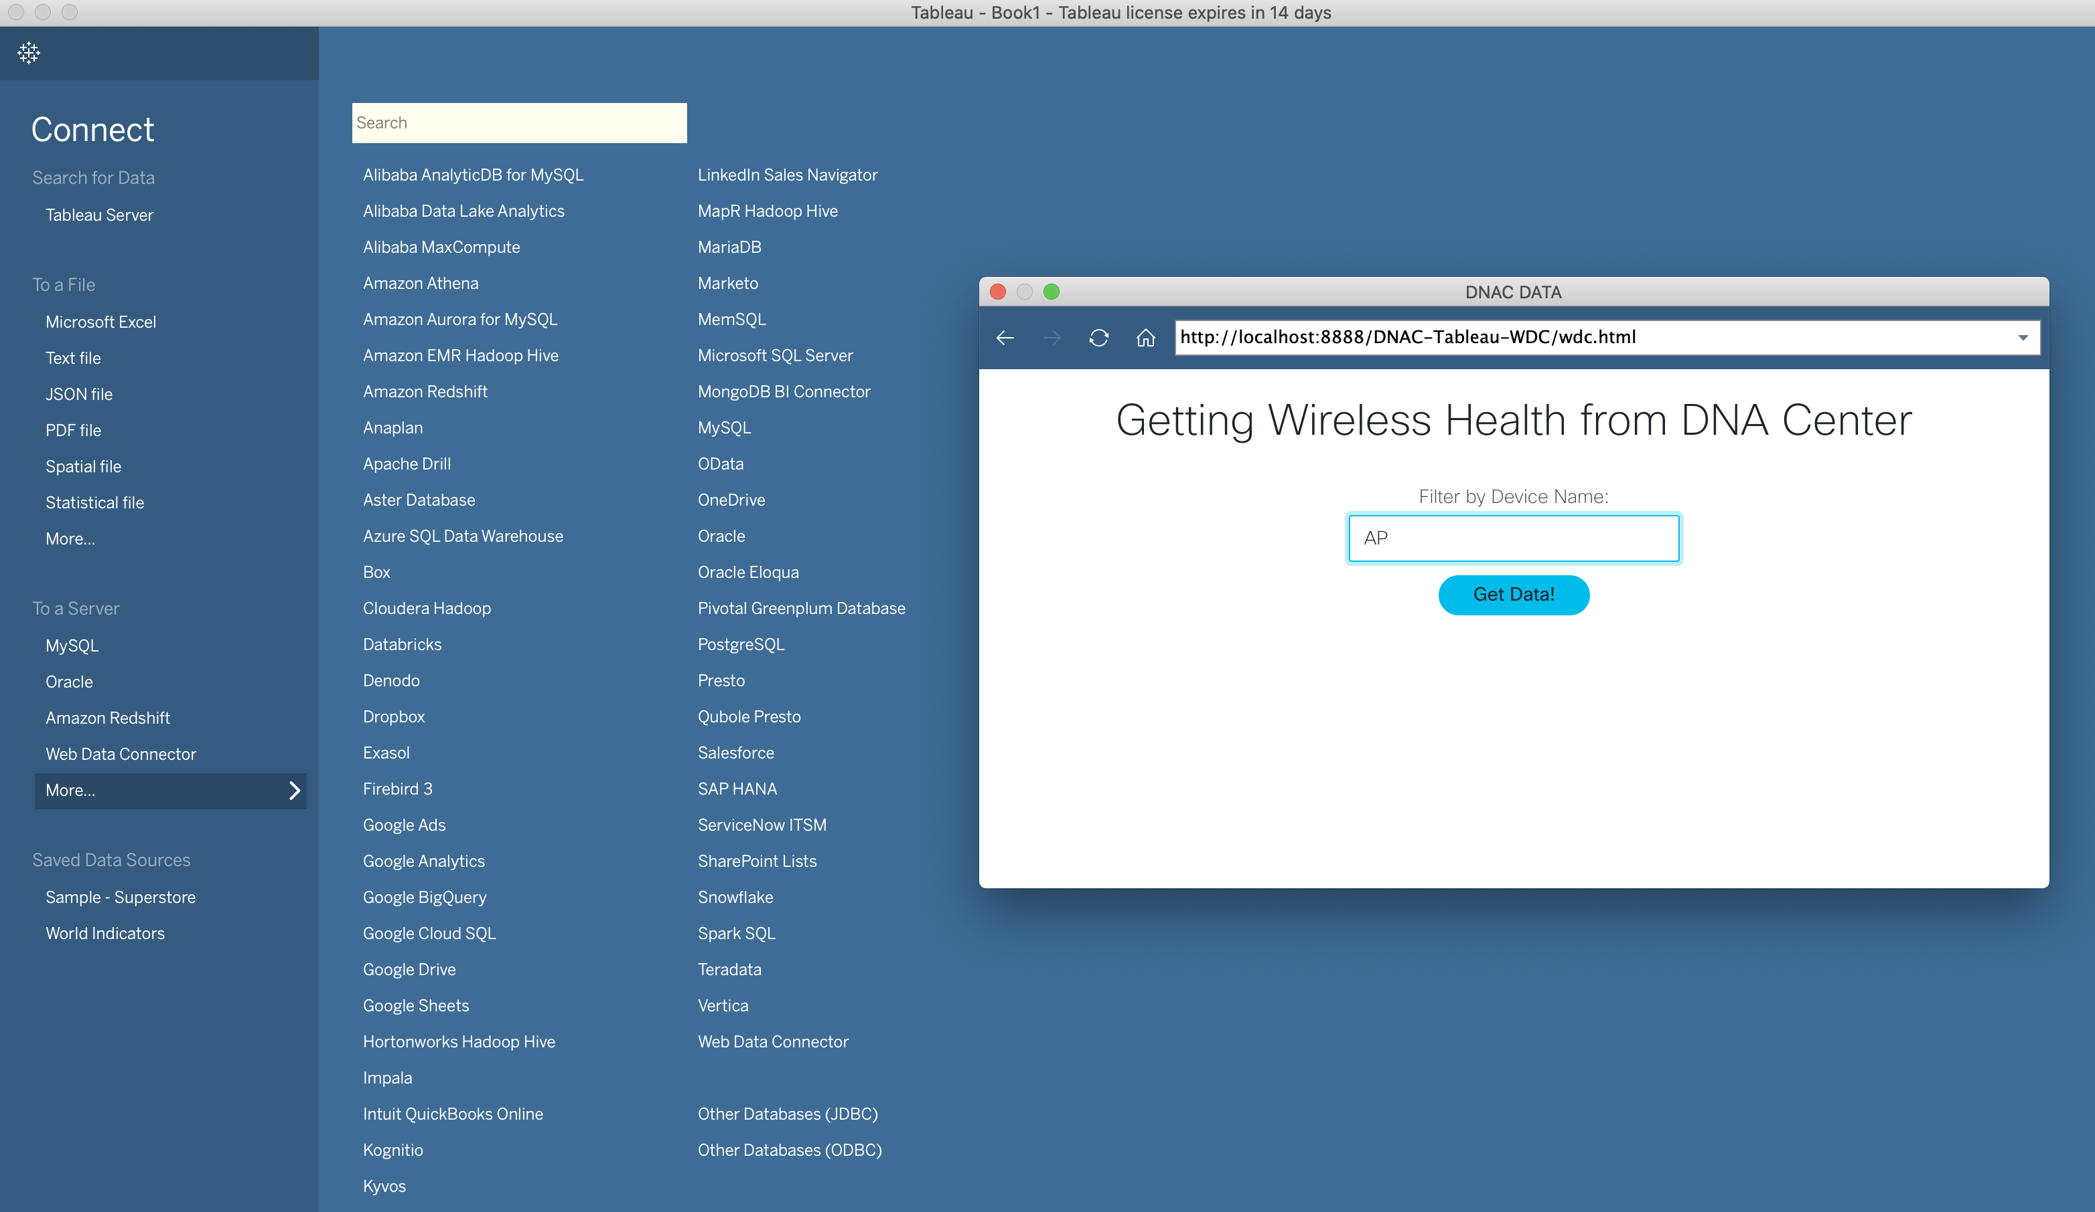
Show GUI or mockup
Notes:
Notes :
Some of the PoVs are developed either Sandboxes from dcloud, devnet or customer premises lab.
In the case the PoV is execute under Customer Premises Lab and would be hard to replicate the PoV, Please record video with the Demo and add the link to it.

Slide 8
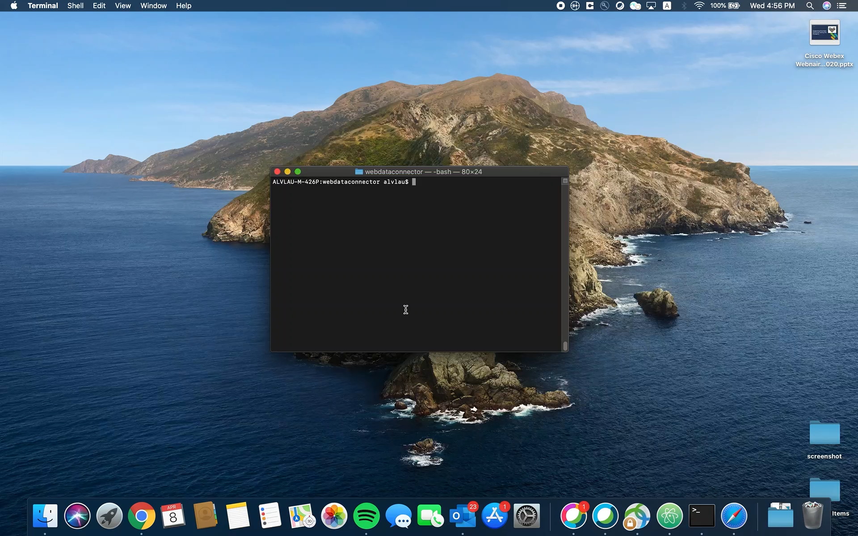
Show GUI or mockup
Notes:
Notes :
Some of the PoVs are developed either Sandboxes from dcloud, devnet or customer premises lab.
In the case the PoV is execute under Customer Premises Lab and would be hard to replicate the PoV, Please record video with the Demo and add the link to it.

Slide 9
Tools (products) Used
Ex Tools and Products:
DNA Center
Tableau
HTML
Javascript
Notes:
Notes :
Describe all the tools,
If there is a need for a specific licenses or code versión or hardware specifications mentioned here

Slide 10
Check out the GVE Devnet team @
https://gve-devnet.cisco.com/
Open a GVE case @
https://cep.cloudapps.cisco.com/case

